Slide 1


Curriculum Overview for First Grade
*Math
*English Language Arts
*Enrichment

Slide 2
Saxon Math 2
Math skills will build on the concepts they should have learned by the end of kindergarten. The students will gain a better understanding of number concepts and will expand their math abilities. The student will be expected to perform these math skills by the end of First Grade..
Number Sense/Counting-Count by 1s, 2s, 5s, 10s, and 25s past 100; Read, write, and understand numbers to 999; Identify numbers in the ones and then tens place in a two-digit number; Demonstrate an understanding of the parts-to-whole relationship by modeling simple fractions (1/2, 1/4, and whole) using manipulatives and pictures
Adding & Subtracting- demo. understanding of symbols =,-,=; Solve addition and subtraction problems with one- and two-digit numbers; add and subtract two/three digit numbers; create/solve problems with a known answer (i.e 3+_=5); solve simple story problems.

Slide 3
Cont…..
Time & Money- Tell time to the hour, half hour, 5 minute intervals, minute on a digital AND analog clock; relate time to events (i.e. longer, shorter, before, after); read a calendar-i.d month, date, days of the week); count combinations of quarters, dimes; nickels and pennies to at least $1.00.
Measuring and Comparing -1 more, 1 less, 10 more, 10 less; <,>,=; comparing and ordering numbers to 100; weight, length, volume
Shapes, Graphs, and Data Analysis - collect and organize data in tally charts, bar graphs and line graphs; i.d, describe/extend repeating patterns, 1 & 2 dimensional shapes.
Classify and Estimate- Estimate answers to addition and subtraction problems; estimate # of objects in a collection; classify objects by common attributes

Slide 4
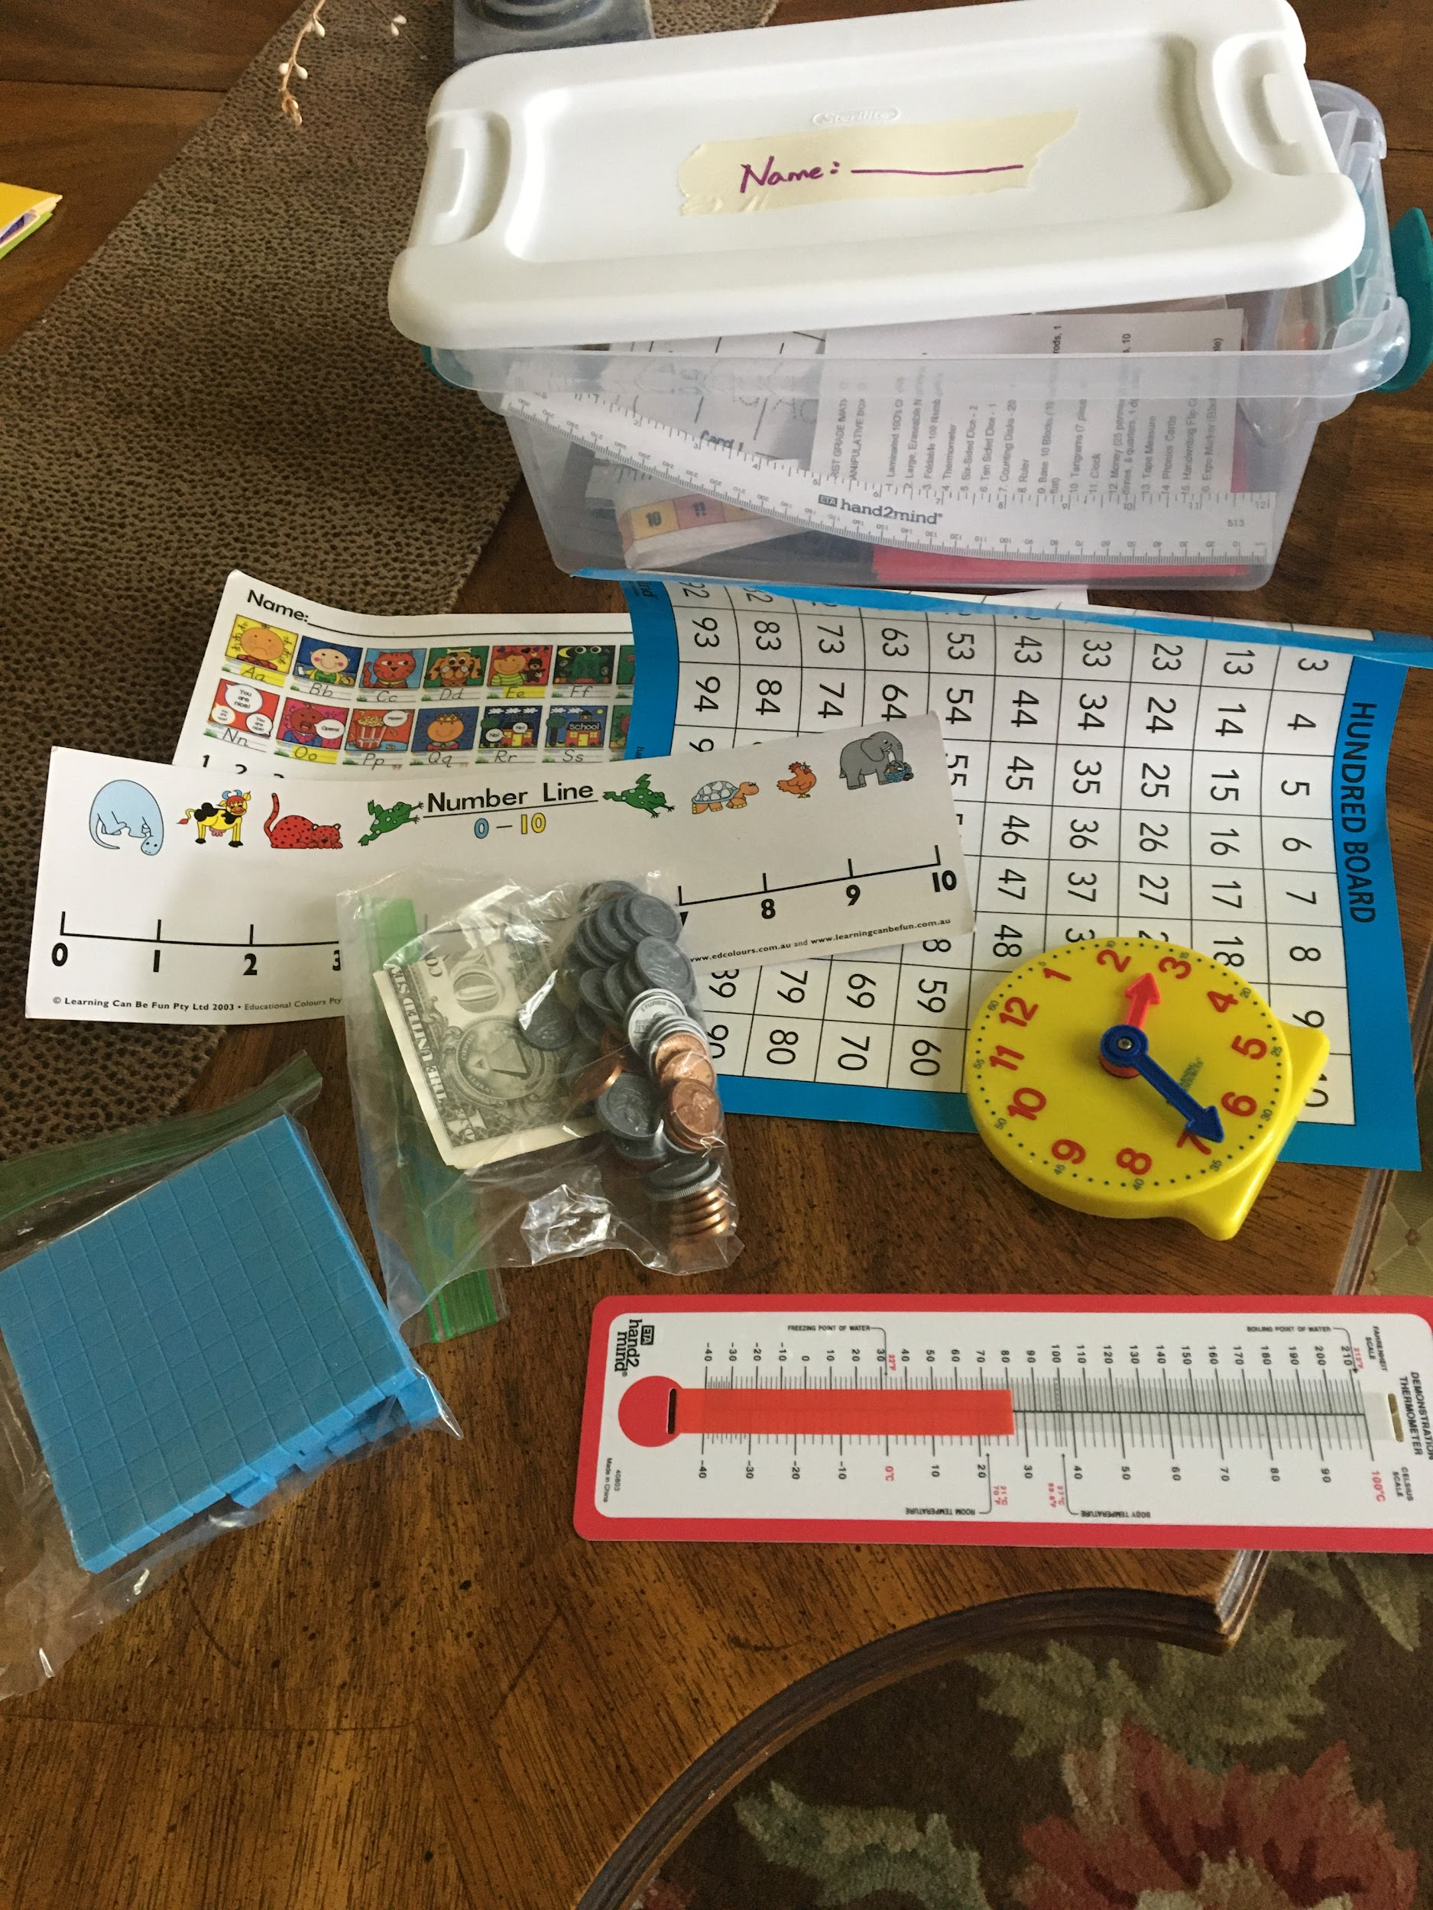
Math Expectations of Parent
Grade EVERY Math page- carefully! When your student misses a problem, discuss what was missed, reteach if needed, and then have them correct over to the side of the problem. *Use the back of your Math pages if extra practice is needed.
Use the Math Manipulative Box (pictured below)for help. Keep it near your work area. If you are not sure how to use it, ask me, ask a friend who might know, and there is always help online!
You are the tutor!
Try to incorporate the math skills into life!
EVERY DAY!

Slide 5
English/ Language Arts
By the end of First Grade in English, the students will be expected to have gained the following skills…
Reading- understand/use new words; read words by sight; read unfamiliar words using phonics; read with purpose and understanding; ask & answer questions; main idea/ details; retell a story.
Writing- use basic English rules like capitalization and punctuation; learn basic parts of speech; print letters of alphabet, uppercase and lowercase; spell unfamiliar words phonetically (by sound); write composition pieces that will be informational, opinion, realistic fiction, and a fairy tale.

Slide 6
ELA Cont...
Shurley Grammar- First Grade is the first year of Shurley Grammar at CLPS. By the end of the year, the students will be able to identify/understand the following parts of speech in the English language: noun, verb, adverb, adjective, article, preposition, prepositional phrase, pronoun, and conjunction.
We will begin learning how to classify a sentence.
You will receive a link to the digital Shurley Grammar textbook that will help you at home. It will have the phonics learned each week, as well as, phonic rules & sounds, and jingles that will help with parts of speech.
Shurley English: An introduction for Parents video link:
** https://www.youtube.com/watch?v=vLQ12ePxKuQ

Slide 7
ELA Expectation for Parents
Hold your child accountable once something is learned! (ie- capital at beginning of sentences, end marks, proper spelling once a word has been learned, correct handwriting).
You are the teacher too! If you can’t read something, they need to rewrite it.
Phonics! New sounds are learned WEEKLY! If your child hasn’t 100% mastered some (and they won’t), PLEASE continue to work at home on them. This is so important! Utilize the 1st Grade videos for extra practice. https://www.clpsfamily.com/first.html
Satellite Reading time- Needs to be a MINIMUM of 15 min./ DAILY out of the assigned leveled book. The parent is expected to sit next to the student as they read. You will help them work through unfamiliar words using phonic skills, as well as, use the Guided Level Reading questions under “Reading Resources,” on the First Grade web page. Every time!

Slide 8
Writing Composition
Writing Composition Binders will be used and will come back and forth from school to home- EVERY DAY. All composition assignments for home and classroom will be in it for each unit.
IMPORTANT! Please complete the lesson on your assigned Satellite Day. The class day lesson will always follow what YOU did the day before. If your student does not complete their assigned lesson with you, they will be behind on the next class day.
See https://www.clpsfamily.com/first.html for Writing Composition overview, as well as some student samples of what a typical student might produce at the beginning of the year.

Slide 9
Enrichment
Curriculum is used to cover the subjects of Science, Geography, and History.
Centers around a classical “read-aloud” book each week, and integrates science, geography, history/ culture, and the arts.
In Science, this curriculum will introduce students to scientific vocabulary, nature discovery, and observation skills.
Geography, History/Culture introduces significant people/events relevant to the establishment of America, as well as foundational Geography concepts
Arts- consists of poetry, well known pieces of art/artist. and music/composers and their rich cultural heritage.

Slide 10
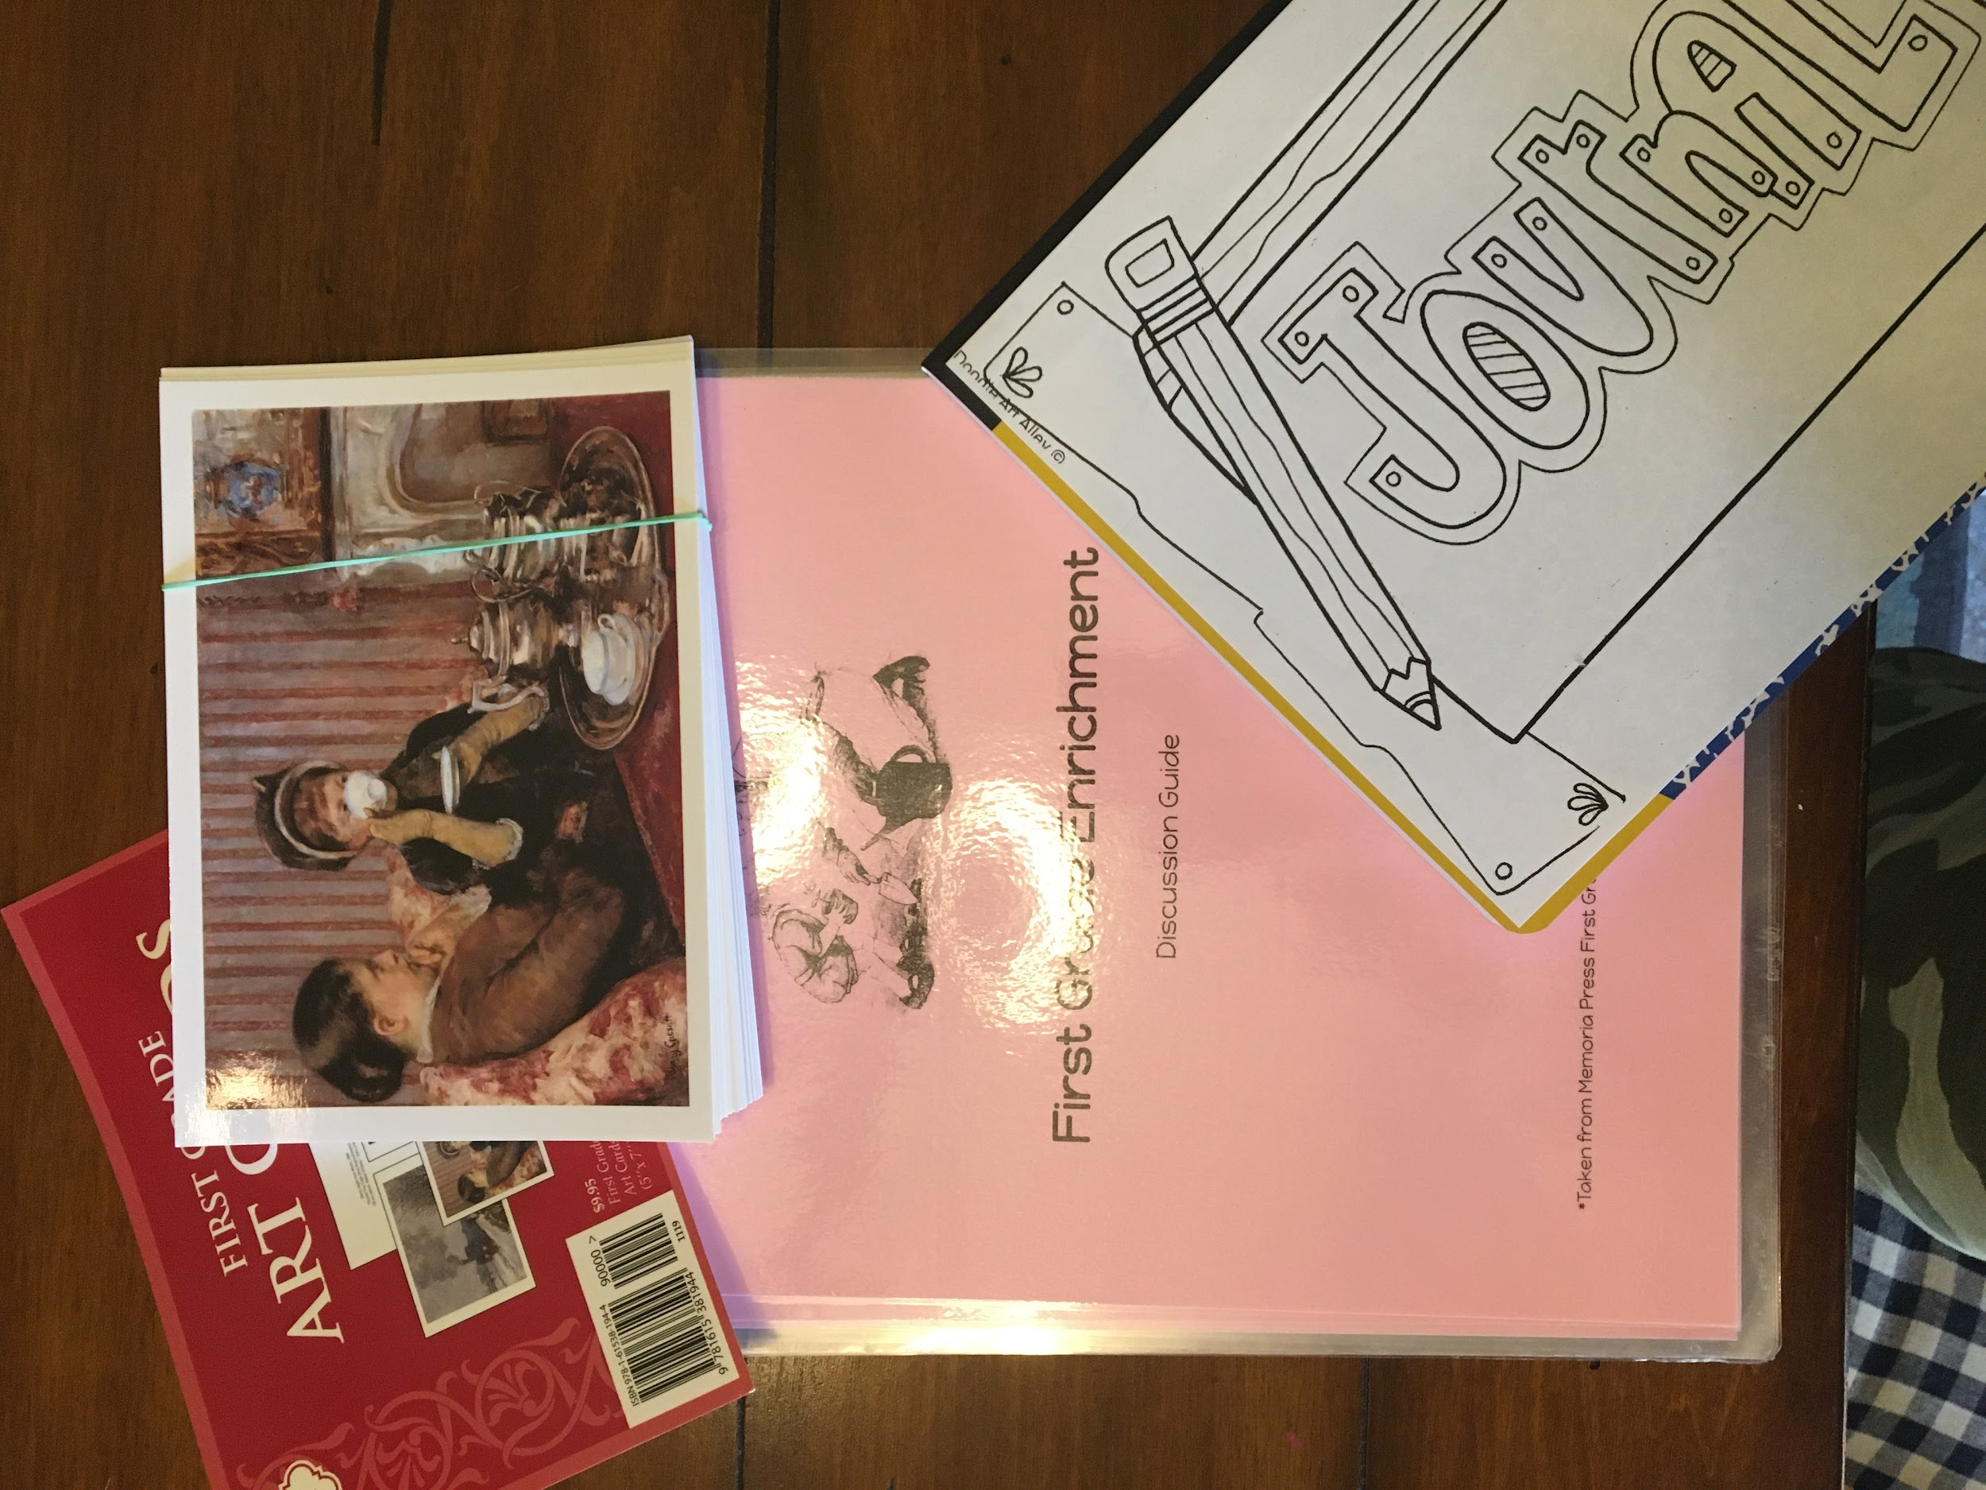
Enrichment Expectations for Parent
This is a Pass/Fail course. The time expectation for this part of the day is 1 hour. Your student will get as little or as much as you put in with them at home.
Read the poetry of the week and listen to the weekly music selection.
Supplies: First Grade Enrichment Discussion Guide (pink), art cards, Enrichment Journal- to be used throughout year at home AND school. Bring this to class EVERY DAY.
* You also have a supplemental book for Science
To use at your leisure- The Nature Reader

